Slide 1
Intelligence

Slide 2
Intelligence
Intelligence: mental quality consisting of the ability to learn from experience, solve problems, and use knowledge to adapt to new situations.
Intelligence test: a method for assessing an individual’s mental aptitudes and comparing them with those of others, using numerical scores.

Slide 3
Intelligence
Intelligence is a construct that is not well-defined.
How do we operationalize “intelligence”?
Depends on how we define it.
Intelligence is a socially constructed concept.
Cultures deem “intelligent” whatever attributes enable success in those cultures.

Slide 4
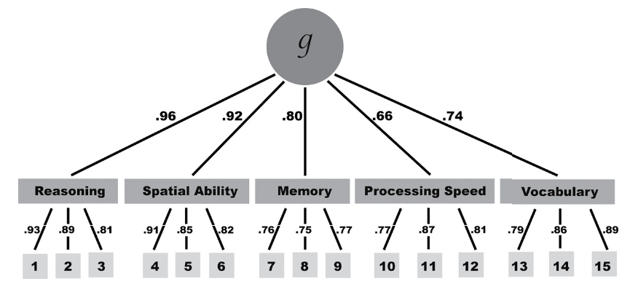
Theories of Intelligence
Spearman’s g
People who scored high on one area of a test tended to score higher on other areas.
One general intelligence (g) that underlies all mental abilities.
Does not make allowances for different sets of abilities.

Slide 5
Theories of Intelligence
Thurstone’s Primary Mental Abilities Theory
Identified 7 clusters of primary mental abilities.
Scores from 7 factors provided more information than the score from one factor (distinct factors).
Those who scored well in one of the seven clusters tended to score well on others.
Analogy of intelligence and athleticism.

Slide 6
Theories of Intelligence
Sternberg’s Triarchic Theory
Analytical intelligence: solving well-defined problems having a single right answer.
Creative intelligence: reacting adaptively to novel situations and generating novel ideas.
Practical intelligence: required for everyday tasks, which may be ill-defined, with multiple solutions.

Slide 7
Intelligence
Theories of multiple intelligences are appealing and make intuitive sense.
Research has consistently shown that general intelligence scores predict performance in school, jobs, etc.
However, those who score well on general ability tests likely also:
Have opportunities for learning (e.g. socio-economic status).
Are conscientious and persistent.
Understand the culture.
Intelligence as a social construct.

Slide 8
Measuring Intelligence
Stanford-Binet IQ
IQ=(mental age/chronological age) x 100
Score assigned that represents the test-taker’s performance relative to average performance of others of the same age.
Average performance set at 100.
Wechsler: WAIS for adults, WISC for children

Slide 9
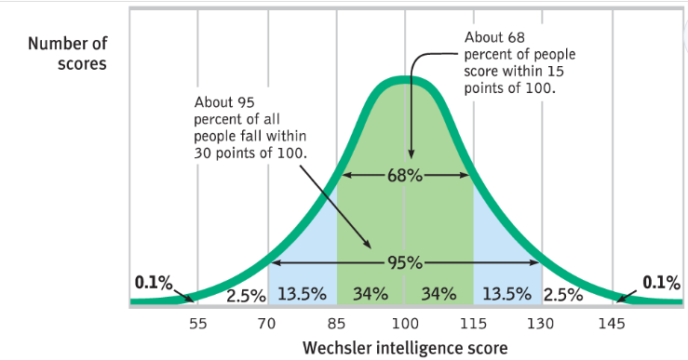
Measuring Intelligence
IQ test scores:
Based on what the "average" person of that chronological age would be able to answer.
Designed so 2/3rds of test takers fall between 85 and 115.
Assume a certain level of education and familiarity with the culture.

Slide 10
Measuring Intelligence
Flynn effect: IQ scores steadily increasing over time.
Tests need to be periodically recalibrated.
Environmental effects? (e.g. nutrition, health care)
Increase in schooling?
Familiarity with test taking?
Adverse impact: employment practices that appear neutral but have a discriminatory impact on a protected group.
Gender differences
Societal expectations and differing opportunities that shape interests and thereby later abilities.

Slide 11
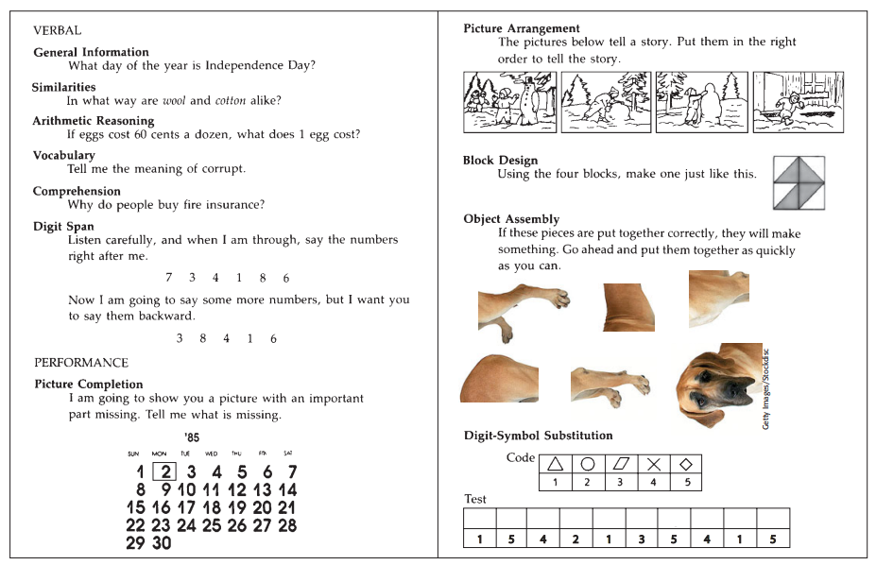

Slide 12
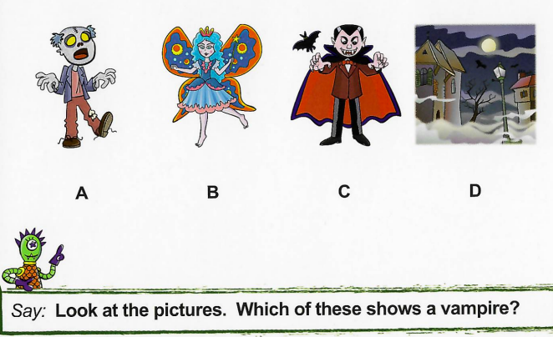
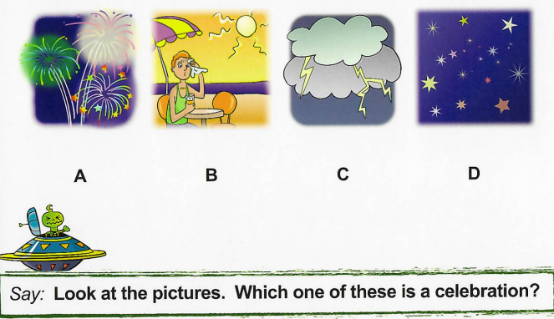
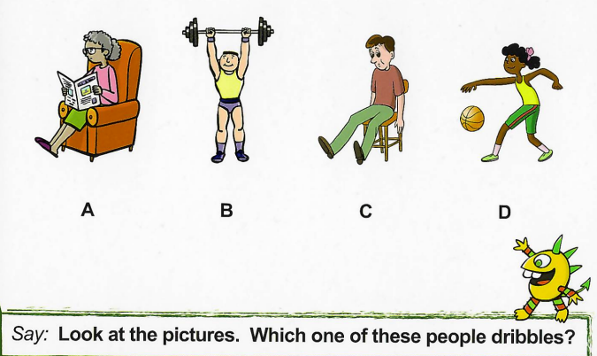
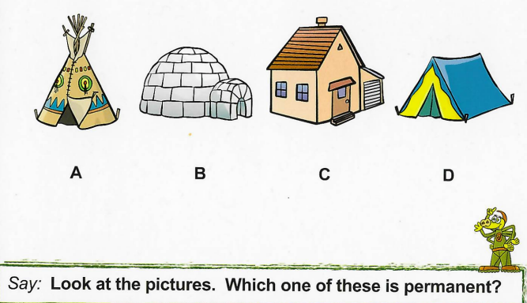

Slide 13
Testing
Achievement tests
Designed to assess what a person has learned (e.g. reading, spelling, arithmetic)
Aptitude tests
Aptitude: the capacity to learn.
Designed to predict a person’s future performance.
Applying existing information into new scenarios (e.g. IQ tests, career placement exams, SATs).
SATs and IQ tests: r=.82
Aptitude and achievement are inter-related: aptitude can lead to achievement, past achievement can increase future ability to learn.

Slide 14
Reliability & Validity
Reliability
Tends to produce consistent scores over time
Validity
How do we define intelligence?
How do we operationalize intelligence?
Predictive validity: extent to which a test predicts behavior it is designed to predict.
Most predictive for small children.
Less predictive as we get older.

Slide 15
Environmental Influences
Enriched environment linked to increased cognitive development.
Poverty and malnutrition linked to diminished cognitive development.
Schooling reflected in intelligence scores.
Fixed mindset: belief that intelligence is biologically fixed and unchanging (external locus of control).
Growth mindset: belief that intelligence is changeable, focus on learning and growing (internal locus of control).

Slide 16
Intelligence Take-Aways
Environmental influences.
Influenced by societal and cultural norms.
Predictive, but adverse impact.
Overemphasis could lead to fixed mindset instead of growth mindset.

